Slide 1
Crash mode analysis
Submitted to - Dr. Shaligram pragapat sir
Submitted by – Ishika Patidar
Roll no. – IT-2K19-22

Slide 2
Contents
1. Purpose 2. Strengths, weaknesses, and limitations
3. Inputs and related ideas
4. Concepts
5. Key terms
6. Software

Slide 3
Purpose
A project network is a tool for graphically depicting a schedule.In This Topic we discusses the use of project networks and the critical path method to evaluate options for developing a system in crash mode.

Slide 4
Strengths, weaknesses, and limitations
CPM (Critical Path Method) is used to help plan and monitor a project schedule when the activity times are known with reasonable precision. Only by shortening the critical path can the project completion time be improved. Consequently, the critical path defines those activities into which additional resources might be poured to accelerate the schedule.
Creating a project network and performing crash mode analysis are complex undertakings. The computations are straightforward but non-trivial. Errors in computing earliest event times, latest event times, and slack times are not always apparent, so all computations should be checked carefully. Finally, the accuracy of the project network is no better than the activity duration estimates, and the accuracy of the cost computations is no better than the cost estimates.

Slide 5
Inputs and related ideas
Before preparing a project network, the tasks or activities to be performed must be identified and each activity’s duration (the time required to complete the activity) and cost must be estimated. Additionally, the precedence relationships between activities must be known. The necessary information is typically collected during the problem definition and information gatheringstage of the system development life cycle

Slide 6
ConcEpts
In This topic we discusses the use of project networks and the critical path method to evaluate options for developing a system in crash mode. Often,it is possible to expedite a project by pouring additional resources (personnel, computing power, etc.) into one or more critical path activities, essentially trading cost for time. Crash mode analysis is a technique for studying the cost/time tradeoff by manipulating the project network

Slide 7
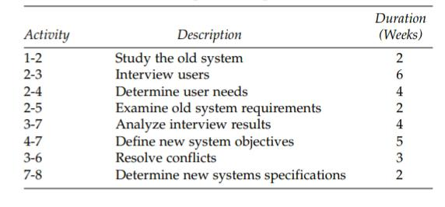

Slide 8
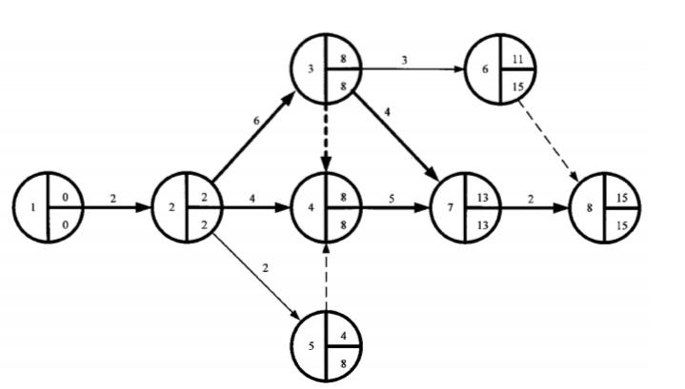

Slide 9
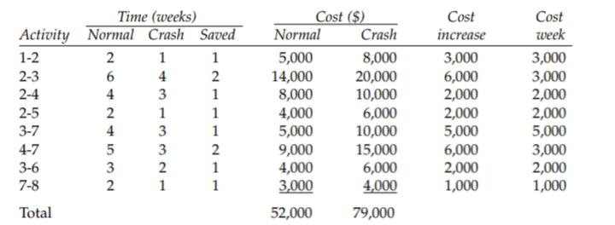

Slide 10
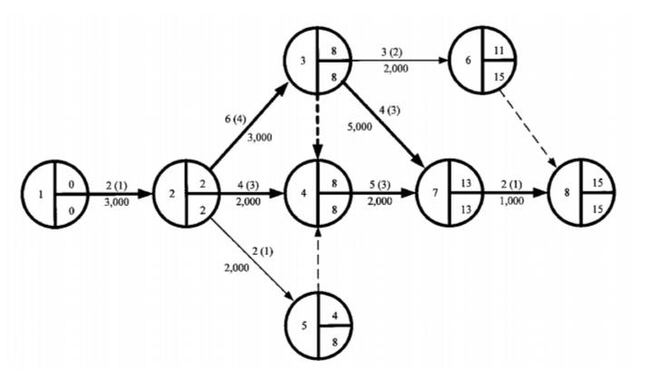

Slide 11
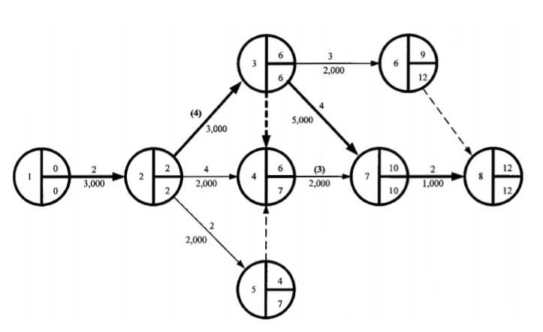

Slide 12
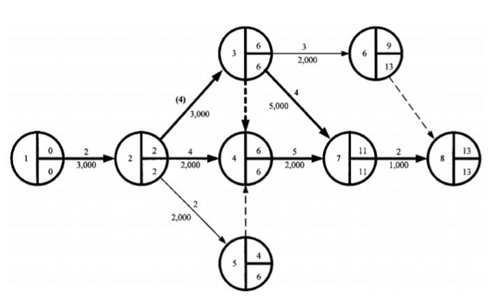

Slide 13
